Slide 1
Final Project
Shuo-Yen Chueh

Slide 2
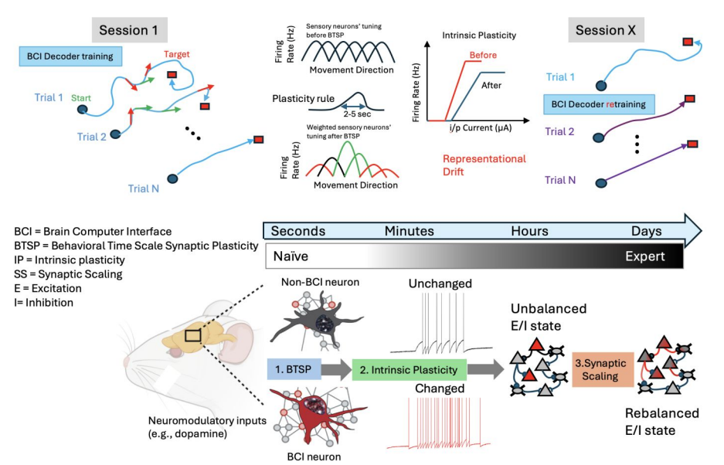
Introduction: Brain computer interface experiment
Metaplasticity model features: Intrinsic plasticity Behavior time scale plasticity Synaptic scaling
Through BCI task, the neuromodulatory influence and repeated activation result in the representation drift.
The representation drift will also affect the BCI performance
Chueh, S.-Y., et al. (2025). Metaplasticity and continual learning: Mechanisms subserving brain computer interface proficiency. bioRxiv.
Notes:
This is the experiment that previous people in our lab was doing.
It’s called brain computer interface or BCI experiment to investigate the plasticity and excitability change of selected pyramidal neuron in motor cortex L3-L5
Metaplasticity model for BCI learning and skill consolidation featuring interaction between three elements: behavioral time scale synaptic plasticity (BTSP), intrinsic plasticity (IP) and synaptic scaling (SS) taking place over a multitude of time scales. During the first training session, rewarded neural activity patterns result in an increase in their frequency over seconds to minutes. Through neuromodulatory influence and repeated activation, changes in intrinsic excitability result and may persist over longer periods of hours, depending on the frequency of training.
The shift from this homeostatic state leads to an unbalanced excitation/inhibition (E/I) state within local circuits that could affect non-BCI neurons.
The balance is eventually restored through synaptic scaling over much slower time scales of days and weeks.
The restoration of this balance might not re-instate the original excitability state of each individual cell but may result in a new ‘attractor’ state of the ensemble.
These changes could explain the representational drift typically observed over similar time scales that adversely affects BCI performance.

Slide 3
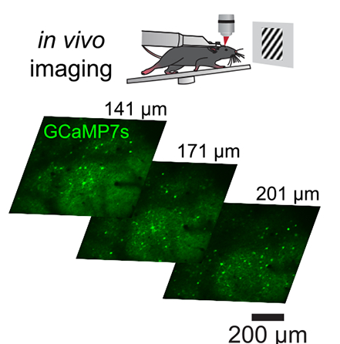
BCI task set up
The monitor will generate drift grating pattern.
If the selected neurons have calcium activity, the signal will be fed in the 2P system and cause the drift grating moving faster rightward.
There are other selected neurons which have negative weight.
The goal is encouraging the mouse to learn to move the grating for certain threshold distance.
Bounds, H. A., et al. (2023). All-optical recreation of naturalistic neural activity with a multifunctional transgenic reporter mouse. Cell Reports
Notes:
The brief explanation of the experiment set up.
The mouse was head fixed under the two photon microscope and there was a monitor that generated the drift grating pattern.
On two photon side, we selected two or four neurons to form an ensemble.
The real time calcium signal would feedforward to the computer to move the drift grating pattern.
If there were two neurons, the weight of them would be 1 and -1. So the mouse will be able to modulate the patter in both direction.
These code were made by previous student who already graduated. My goal is analyze the behavioral result like the how long of each section, their success rate, trial numbers….etc

Slide 4
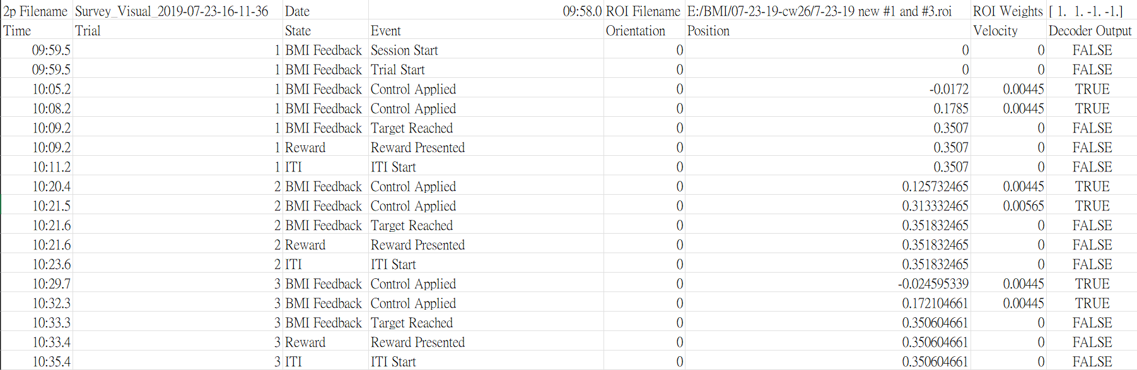
Behavioral data format
Behavioral experiment set up
Trial 1
Random start point
Trial 2
Notes:
After each section is finished, the behavioral data will be saved in this format.
You can see the trial number. The starting point will be assigned randomly for the new trial.

Slide 5
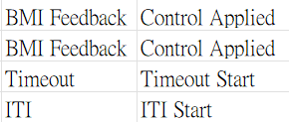
Behavioral data format
Behavioral experiment set up
Trial 1
Random start point
Trial 2
There are also other parameters to tune the behavioral set up, e.g. Impulse, max_velocity, stop & start threshold, random_start_range, ITI length…etc
Failed trial if time out

Slide 6
The purpose of original MATLAB code
Extract the basic information: 1. Time of section duration 2. Total trials and successful trial count 3. Success rate and reward frequency 4. Average and standard deviation of trial duration
Visualization of trajectory: 1D & 2D version, Trial path length.
Batch file analysis: Output a summarization file.
Ensemble-based group analysis: plot the bar chart of each neuron ensemble giving the statistics results.

Slide 7
Project Goals
Output the same figures and files regarding the same input CSV file.
List the necessary functions for processing the data frame and write them as def functions.
Have the notation of each def function to ensure modification in the future.

Slide 8
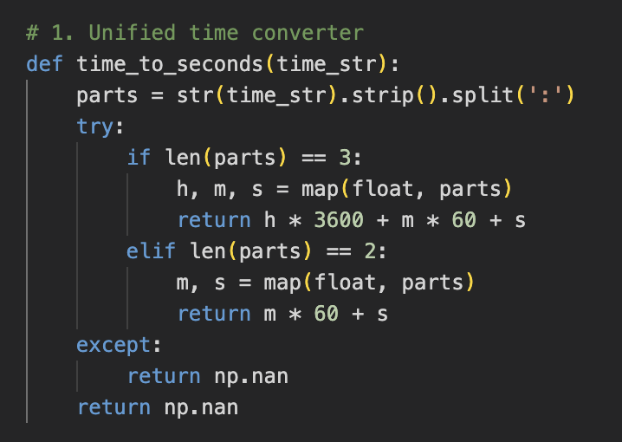
Function 1: time_to_seconds
Ensure input is the string.
Remove any extra space by .strip()
Split the time string into [‘HH’, ‘MM’, ‘SS’]
Covert them into second unit and compute the total duration.
Use this to calculate the average & standard deviation of trial duration.

Slide 9
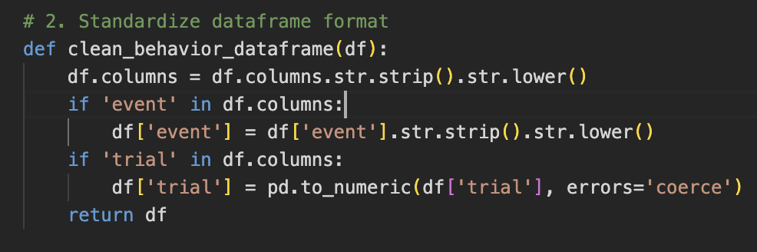
Function 2: clean_behavior_dataframe
Strips whitespace from both ends of each column name
Convert ‘event’ column names to lowercase (e.g. Target Reached -> target reached) to avoid missing event.
Convert ‘Trial’ column to numeric and find the total trial number by using “.unique”
Return the clean data frame
Notes:
ChatGPT suggest to do this part first.

Slide 10
Function 3: analyze_behavior_data
Clean the data by the previous functions. Measures total time span (in seconds) from the first to last timestamp in the file
Extracts all unique trial IDs (excluding any NaNs) and counts how many total trials occurred in the file
Filters for rows where the event was "target reached” and counts the number of distinct trials that had a successful outcome
Success Rate: % of trials that ended in success. Reward Frequency: how many successful trials occurred per minute
For each trial: Gets its start and end time and calculates how long the trial lasted (in seconds)

Slide 11
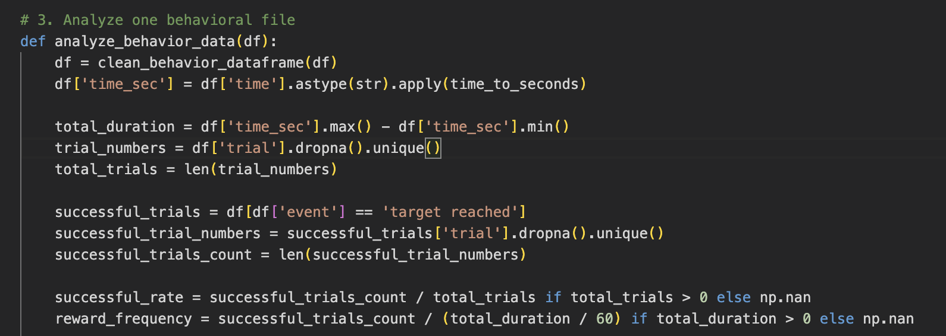
Function 3: analyze_behavior_data
Use the clean data frame and calculate the total duration, trial number, total trials in time_sec column and trial column.
If “target reached” show up, that means a successful trial.

Slide 12
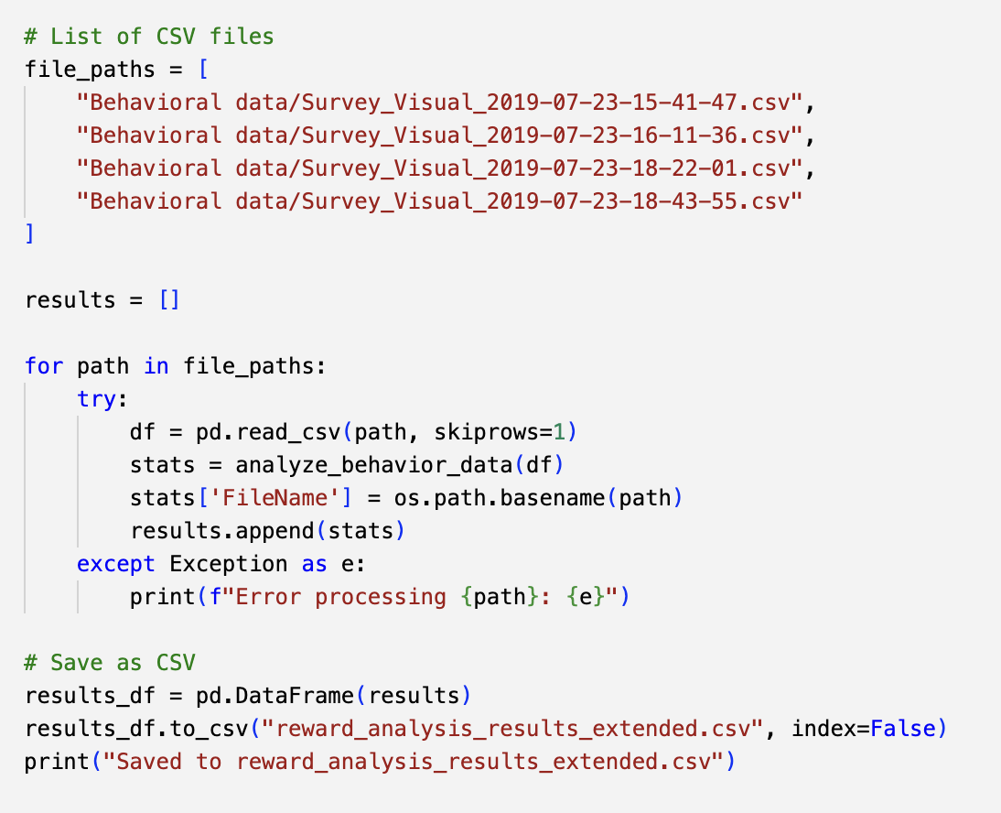
Notes:
Use this for loop to process several behavior data and combine them together into single CSV file and save it.

Slide 13
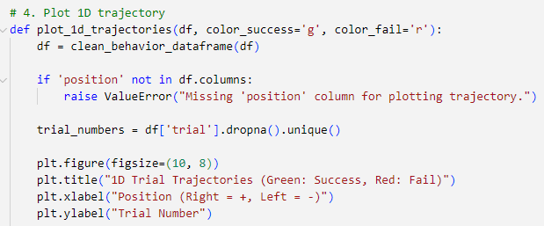
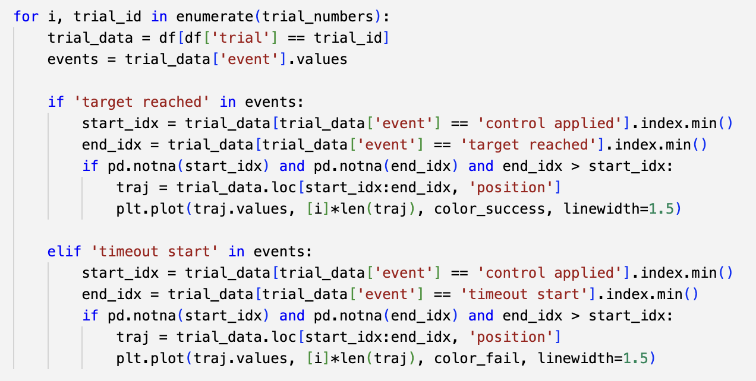
Function 4 & 5: Visualization
Visualize each trial as a 1D line of movement, using Position vs. Trial Number.
Get a list of unique trial IDs. Loop ( for and if loop) through each trial to plot its trajectory.
Successful trial
Failed trial
Notes:
ChatGPT help making the if loop that process the trajectory within each trial

Slide 14
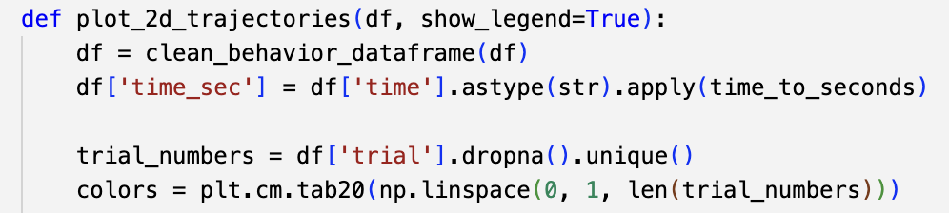
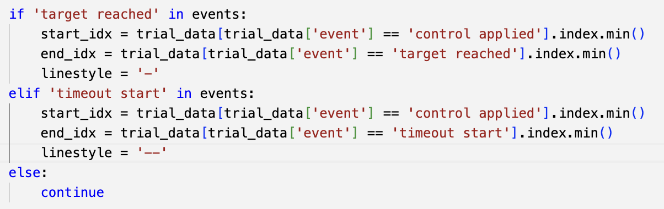
Function 4 & 5: Visualization
Clean the data frame and assign a distinct color to each trial.
’target reached’ is the sign for successful trial. ‘timeout start’ for failed trial.

Slide 15
Behavioral data format
Behavioral experiment set up
Trial 1
Corresponding position
Trial 2

Slide 16
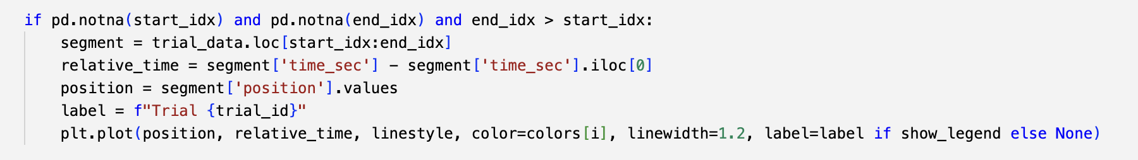
Function 4 & 5: Visualization
Extracts all rows between the start and end of a trial. This is the time window from "control applied" to "target reached" or "timeout start”
Converts absolute time → time relative to trial start. Sets the time at control applied to 0.0 seconds. This helps normalize across trials of different start times.
Extract position data and plot.
Notes:
Extract the data of this trial (from the beginning to the end)
The time is converted to "seconds relative to when control was applied"
Position is the horizontal axis, time is the vertical axis → Draw the dynamics of behavior
If show_legend=True, it indicates which trial each line belongs to.

Slide 17
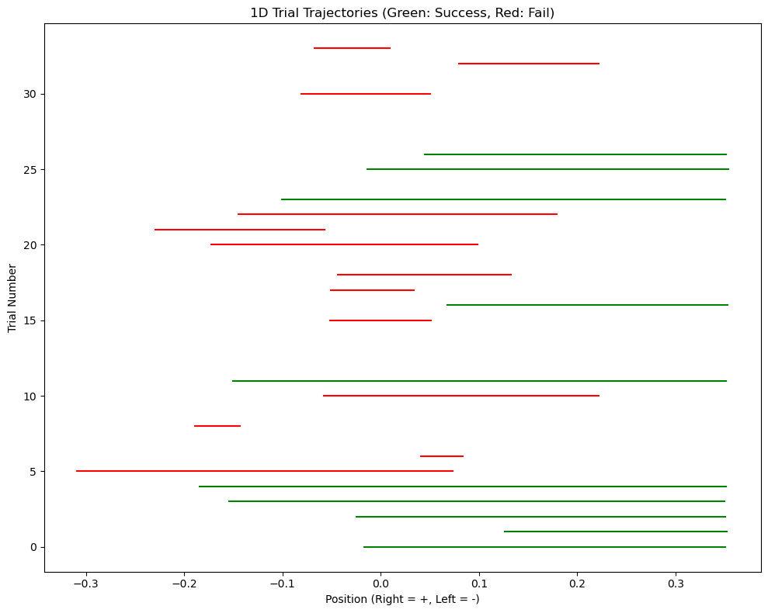
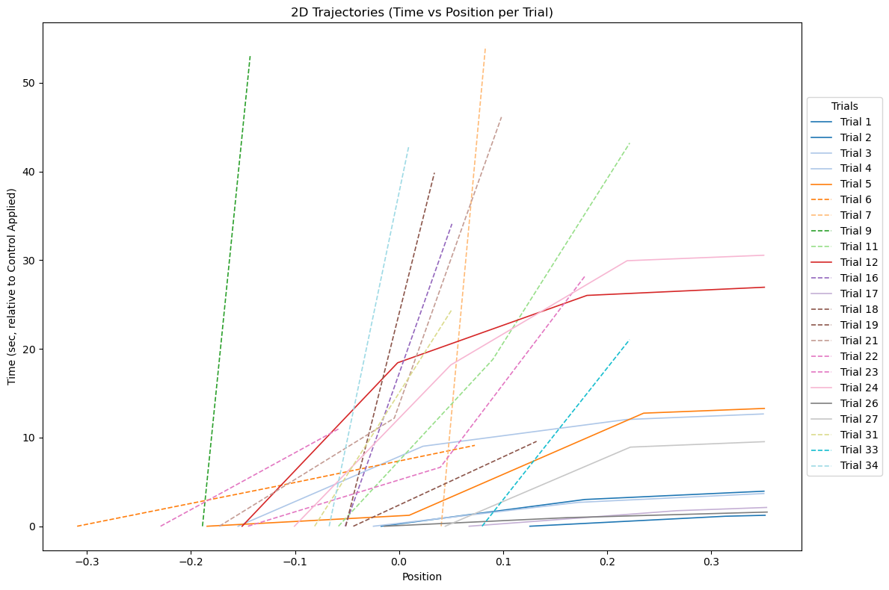
Trajectory plot: 1D & 2D versions

Slide 18
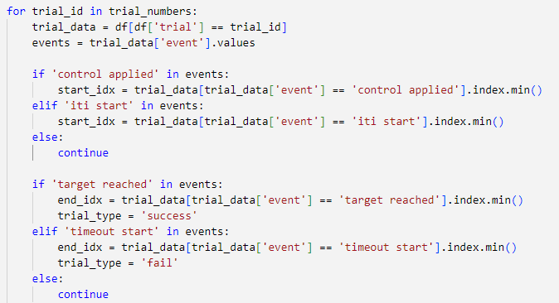
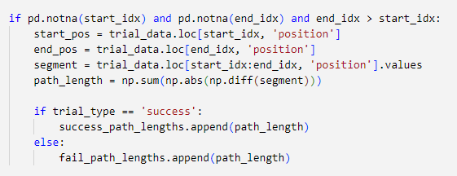
Function 6: calculate_path_lengths
Use “controlled applied” or “ITI start” events as the time point of start.
“target reached” is the end of successful trial. “timeout start” is the end of failed trial.
Loop each trial and selects the continuous sequence of position values from the trial start to the end.
Computes the difference between each position point and the add them all up
This part is not included in the summary CSV file.

Slide 19
Function 7: plot_ensemble_barplots
Add the “Ensemble” column manually.
DataFrame df must include these columns: 'Ensemble’, 'SuccessRate’, 'RewardFrequencyPerMin’, 'AverageTrialTime’
Assigns each ensemble group a unique color for plotting
For each group: Compute mean and standard error, store sample size for plotting

Slide 20
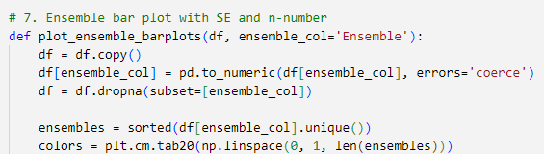
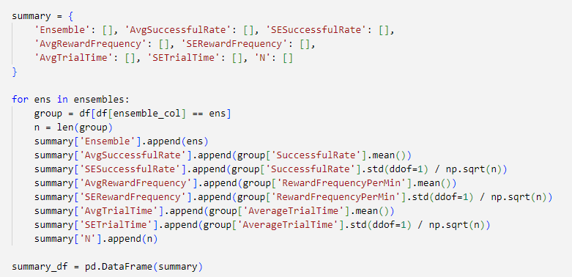
Assign different color to each ensemble
Make sure the Ensemble field is in numeric format
Remove any rows that do not have an Ensemble number.
Initializes a dictionary that will be used to collect statistics per ensemble: Average values (mean), Standard error (SE), Sample size (n)
Loops through each unique Ensemble (experiment group).
Filters the dataframe to only rows matching that ensemble (group)
Stores how many rows there are (n) — used for SE and bar annotation.

Slide 21
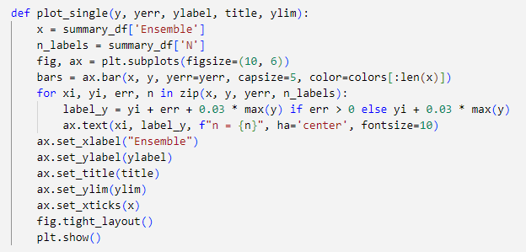
x is the x-axis position of each bar (Ensemble number) and n_labels is the number of samples in each group (later used to label the columns)
Draw a bar chart: Height y (The parameter value), yerr is used as the upper and lower error bars (standard error)
This section adds sample number labels above each bar:

Slide 22
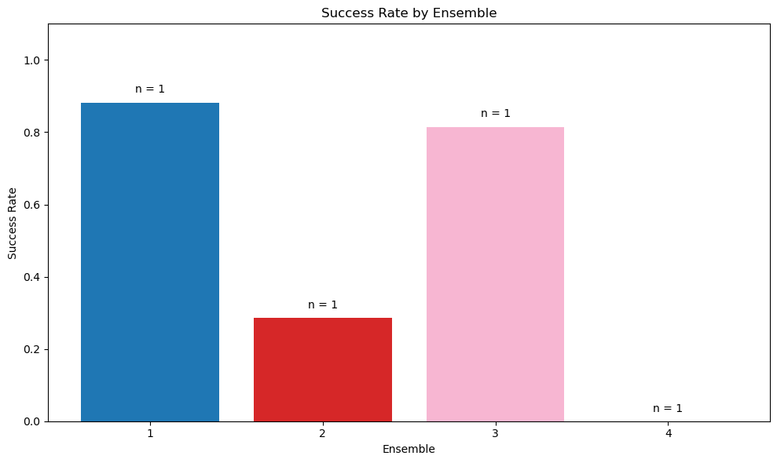
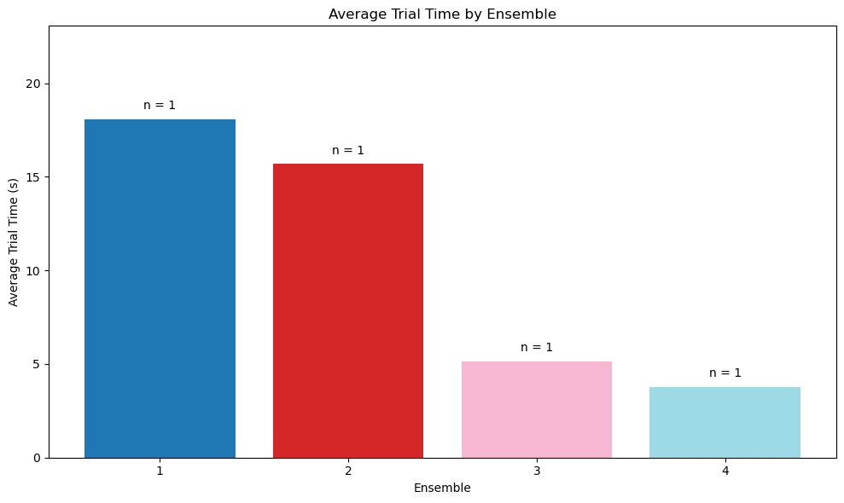
The bar chart of success rate & average trial time of each ensemble
*Because the sample size of each ensemble is only 1, there is not STD error in this figures.

